Slide 1
Honda Hackathon-2020
Team Nomad

Slide 2
Introduction:
The Introduction to Connected Cars have always been the hot topic in the Real-Time based IoT technology.
Although technology has it's unique perks in ease of access or understanding your car better, its also a distraction in a way. Especially considering the fact that driving is a work that involves having your attention on the road ahead.
Voice Based Service using Alexa is preferred as it is polished to understand voice commands better, even when the user has linguistic inabilities.

Slide 3
Concept: (Personalization)
One of the easiest ways of enhancing user’s experience is to have the system be more Personalized.
Alexa can be inter-twined onto user’s daily routine using Alexa Home. The same account can be linked with Honda Connect application.
Honda connect must be capable of prompting the user with desired information in preferred time. Hence personalizing the application must be a main aspect to look into.

Slide 4
Concept: (Journey Predictions & Estimations)
Have a UI that prompts the user to setup predefined destinations with time and days of the week. E.g.: Having to drive to work every morning at 8:30AM from Monday to Friday and so on.
As Alexa Home does it’s main routine work, the GMaps API in the backend will determine the Traffic in the Route and present the User with full details of the Route with ETA.
Note that if the user does NOT have Alexa Home installed, Alexa application can be Independently run on Honda Connect and perform the same task.

Slide 5
Concept: (Predictive Models to Monitor Health of the Car)
In addition to GMaps API, with the courtesy of the on-board sensors in the car, the voice assistant along with the backend of the application can predict the two main factors of the journey; Feasibility and Ideal aspects of the Journey.
Ideal aspect involve predicting the future conditions of the car based on the parameters collected in prior journeys.
Feasibility involves calculating the fuel consumption, updating mileage in real time and prompting the user about the set journey with the same details.

Slide 6
Concept: (User Preference)
Have an optional preference to the user that lets the application set appointments at the nearest Honda Service Center automatically when the prediction engine finds anomalies in the sensor data.
In addition to predictive analysis, it is ideal to setup individual switches that the user can configure the application as per their preference. E.g.: Disable notifications during driving or after set timings and so on.
Additional to the pitched idea, the team came up with an alternative to the slow GPS updates on the app without compromising the other services provided by the app.

Slide 7
Methodology:
The main aspect of this idea proposals are the automated prediction of journeys and diagnosis of the car. These utilize machine learning. Hence there is a need for data logging system in the On-board Computer (OBC) in order to iteratively train the individual prediction models.
Cars connected to servers as fleets utilize GSM based services. Using an ISP to provide unique E-Sims. 4G LTE provides access to the OBC to communicate with the servers, However in India, all regions are not covered by the ISP in uniform fashion. We also elaborated a standard architecture to overcome the problem to a significant level.

Slide 8
Assumptions and Validation:
While surveying the app and the customer feedbacks, we noticed how sometimes the real time GPS tracking is much slower than anticipated. In slide 11, we showcased a flow diagram that does the data logs and yet keep the communication between the car and the server faster than conventional method.
All the data involving the car’s vitals such as fuel consumption, engine state, window and locks sensing are logged into a file until the file size increases to a threshold amount, (say 25MB). Each log files are uploaded in batches of 25MB.

Slide 9
Assumptions and Validation:
However, GPS data will be the only data that will be transferred in intervals of 1 minute or even 30 seconds. This will reduce the throttling of the server space and keep the communication effective.
With the help of GMaps API and the GPS data with uniform interval, the velocity of the vehicle can be estimated. This concept is derived using Inertial Measurement Systems. None of the services provided by the current application will be obstructed with implementation of this concept.

Slide 10
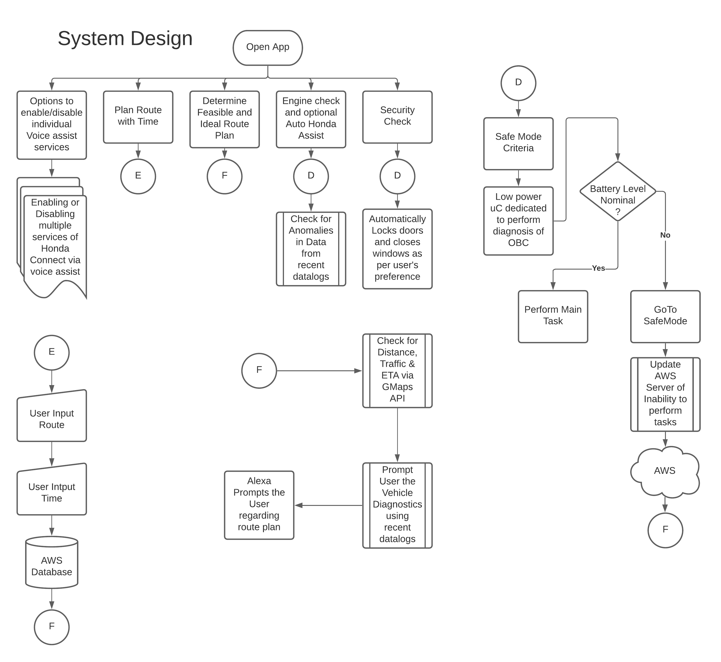

Slide 11
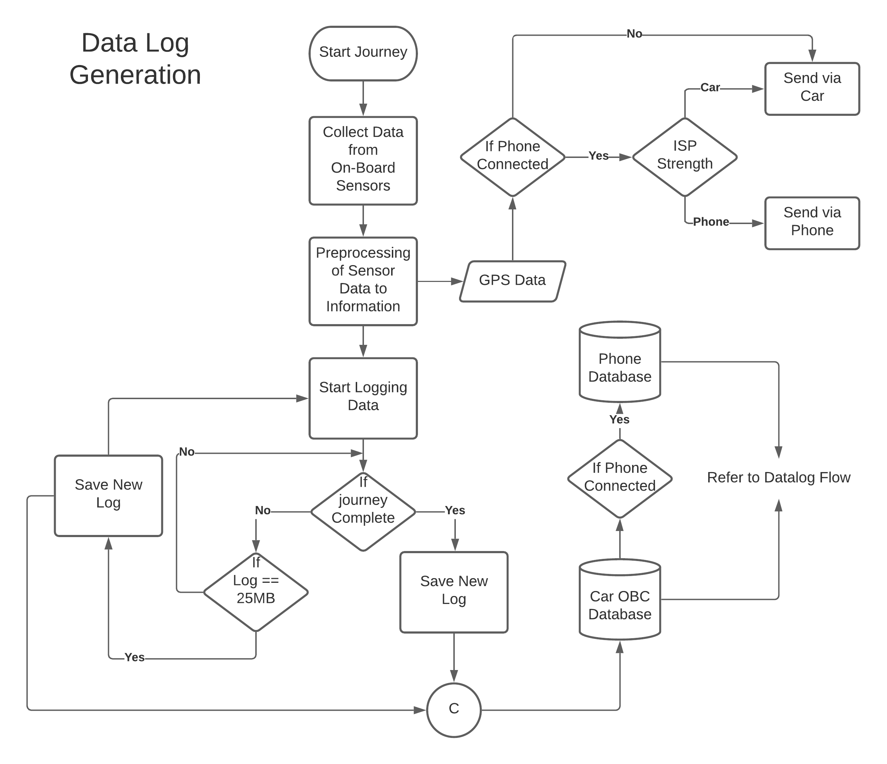

Slide 12
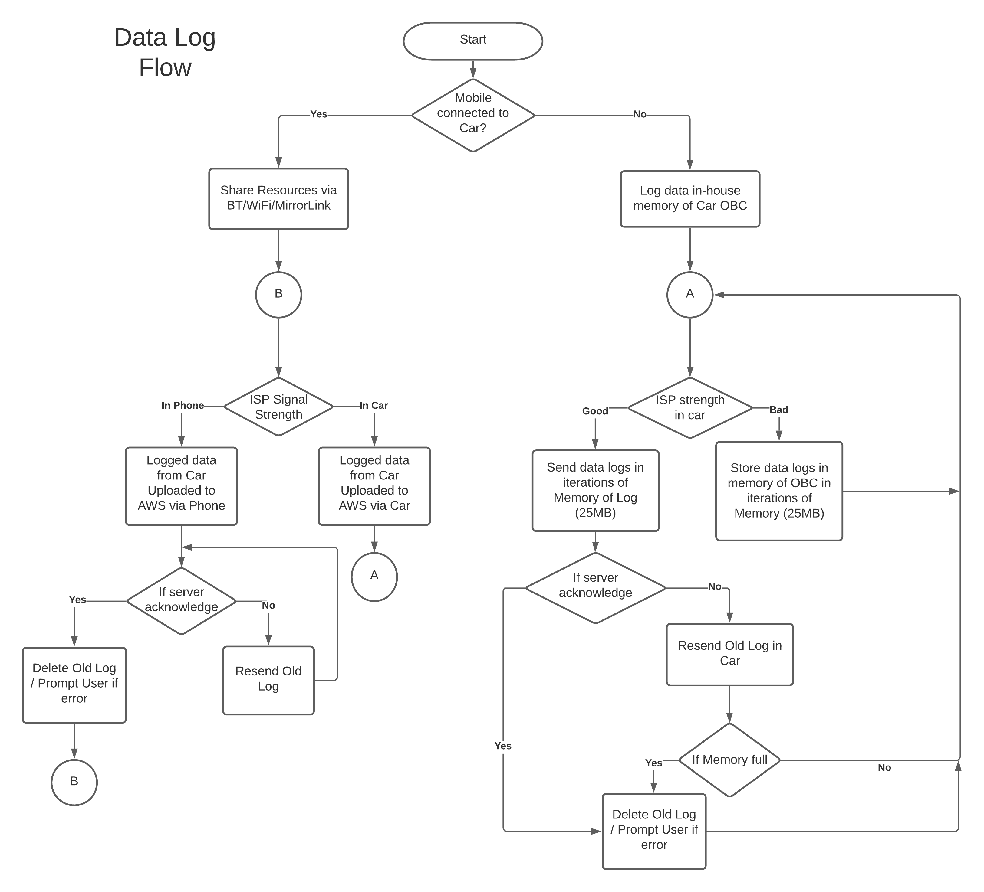

Slide 13
Practical Usability Potential:
With the current technology available to be deployed over a simple software update, a well polished application can end up being more than just a way of accessing your car.
Applications with voice assists like Alexa and the right tools to perform predictive analysis can be a handy tool than just having an app that connects to your car working just as how a car key remote works.
AI is capable of automating in an adaptive manner. With the right architecture, more importance will be given to the user preference than just the technology inside. The practical potential here is that the user will grow a symbiotic relationship with the technology rather than just have a technology the user does not understand.

Slide 14
Relevance and Scalability:
With reference to the theme of the event, this significantly enhances the user’s experience with the application
Having a personalized application with voice assistant will be highly relevant to the user in-car and outside car.
Since most of the architecture is software oriented, a simple update push after implementing the given concept, the older and newer consumers can utilize these services.
When ideating for the event, we took major validation constraints such that The concept must not obstruct the current services provided by Honda Connect.

Slide 15
Conclusions & Future Expectations:
With rapidly Advancing Technologies, Data has proved to be an important commodity. Utilizing the data appropriately to make the user’s experience a breeze is what matters the most when it comes to commercializing the technology.
The team expects that in the future, fleets of Honda cars collecting data on the go using our concept would be used to statistically analyze the performance of the Honda cars of various models and give an insight to the company regarding their products in a much vivid scale. This will provide significant insight for future development.

Slide 16
Conclusions & Future Expectations:
Having personalization features in the future can hold so many potential such as sentiment analysis of the user, multimedia preference, service preference using geofencing and so on. This aspect will significantly increase the user’s experience inside the car.

Slide 17
Prototype Phase Expected Results:
A Basic UI of the app with the said additional features using Journey Prediction and Estimation.
Backend script that logs data based on the predefined set memory (say 25MB) or if the Journey was completed without the log exceeding above the set memory.
A Basic Prediction model that estimates the rate of performance changes of the Engine parameters, Fuel consumption and so on.

Slide 18
Thank You
Team Nomad

